Slide 1
Orion Bus Industries
Contract Bidding Strategies

Slide 2
Observations!
Orion Bus Industries wants to develop a method for determining how to bid on specific bus contracts to maximize expected profits.
In order to do this, it needs to develop a model of winning bids that takes into account such factors as the number of buses in the contract, the estimated cost of the buses and the type of bus (e.g. length, type of fuel used, etc.).
This data set only includes the bus contracts from Exhibit 1 in the case where Orion did not win the contract. This eliminates 28 of the 69 observations and leaves a sample of size n = 41 observations.

Slide 3
Build a model that will help Orion to predict winning bids and allow the company to maximize total contribution (profit).
Run a regression of WinningBid against NumberOfBusesInContract, OrionsEstimatedCost, Length, Diesel and HighFloor, ie, the following regression model:
WinningBidi = β0 + β1NumberOfBusesInContracti + β2OrionsEstimatedCosti + β3Lengthi + β4Dieseli + β5HighFloori + εi

Slide 4
What are the advantages and limitations of your model?

Slide 5
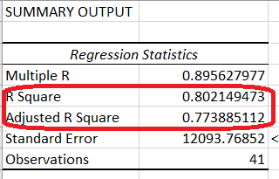
Advantages
R square and Adjusted R Square are of high value
The model works well for 77% of the times
Indicate some high efficiency

Slide 6
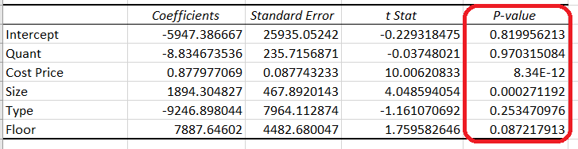
Limitations
Low number of observation (41 observations in total)
Some independent variables are greater than the common alpha (0.05) which indicate that these variables are not statistically significant

Slide 7
The city of Louisville, Kentucky is interested in purchasing five 30-foot, low-floor, diesel-fuelled buses. As the vice-president of sales for Orion, how much would you bid for this contract, based on Orion’s estimated cost of $234,229 per bus?

Slide 8
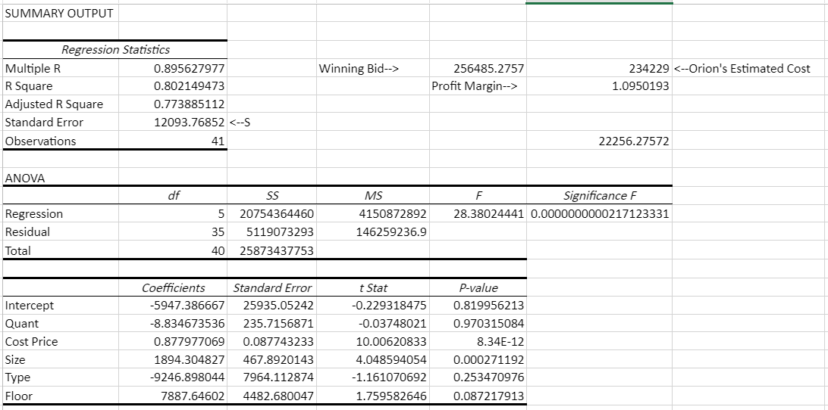

Slide 9

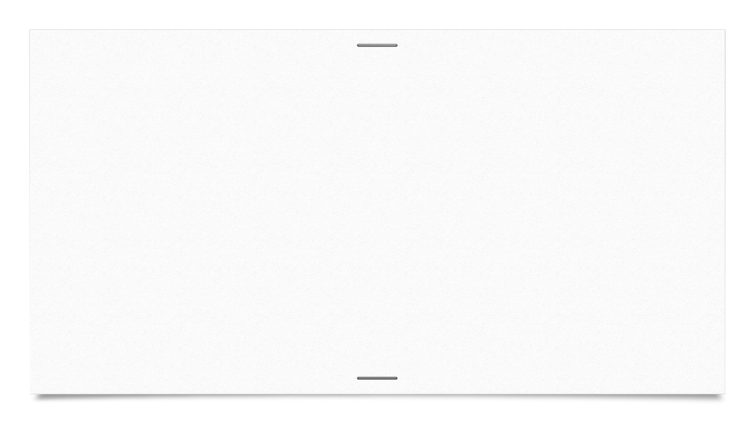

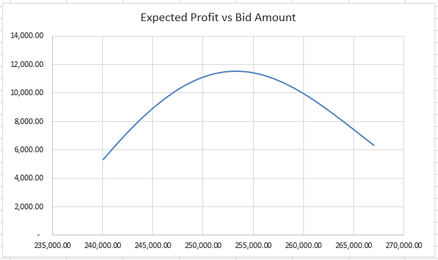
Expected Profit
At BidAmount: $2,40,000 the expected profit: $5,272.26
Maximum Expected Profit ($11,514.10) when BidAmount: $2,53,000

